Slide 1

Exploring Interpretable Neural Network by Quantum representation
Benyou Wang, Qiuchi Li, Prayag Tiwari, Massimo Melucci
University of Padova

Slide 2
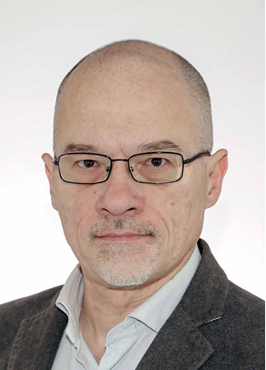


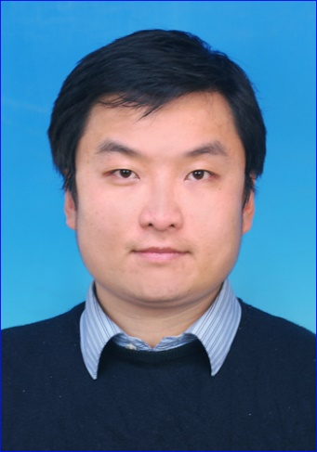
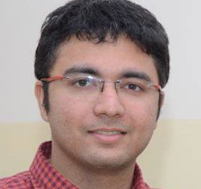
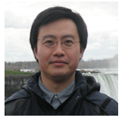
Done with the collaboration

Slide 3
What is Interpretability
Post-hoc explanations
Take a learned model and draw some kind of useful insights
E.g. Visualization in machine translation [Liu Yang &Maosong Sun ACL 2017]
Transparency
Targeting ``how does the model work?'' and seeks to provide some way to understand the core mechanisms
E.g. Capsule Network [Hinton NIPS 2017]
Zachary C Lipton. The mythos of model interpretability. arXiv preprint arXiv:1606.03490, 2016， ICML Workshop on Human Interpretability in Machine Learning
Yanzhuo Ding, Yang Liu, Huanbo Luan, and Maosong Sun. Visualizing and understanding neural machine translation. ACL, volume 1, pages 1150–1159, 2017.
Sabour S, Frosst N, Hinton G E. Dynamic routing between capsules[C]//NIPS . 2017: 3856-3866.

Slide 4
An Pipeline example for text processing
tokenizering
stemming
query
Removing stopwords
Rerank
Prerank
Parsing
Combine multiple results from different sources
Filter some contents if necessary
documents

Slide 5

Transparency in end-to-end Paradigm
https://www.youtube.com/watch?v=TYpBJ71VW9g

Slide 6
End to end mechanism
Less accumulating error
Less involvement with Human beings
Improve performance with shared features of the downstream tasks and upstream tasks
Hard to adjust
Hard to transfer
Hard to understand
We need End to End mechanism, but in a fine-grained way

Slide 7
Design each subcomponents in the End-2-end architecture with a good background of the task
Both language understanding and artificial intelligence require being able to understand bigger things from knowing about smaller parts
Christopher Manning 2017

Slide 8
Motivations
Design self-explainable subcomponents in end2end network
Provides more transparency from the network
Theoretical explanations for why neural network works or why it dose not work

Slide 9
Contents
End to End language model for QA [AAAI 2018]
Quantum Many body function for language model in QA [CIKM 2018]
Quantum-inspired word Embedding [ACL REP4NLP 2018]
Hibert Semantic Space [In process]

Slide 10
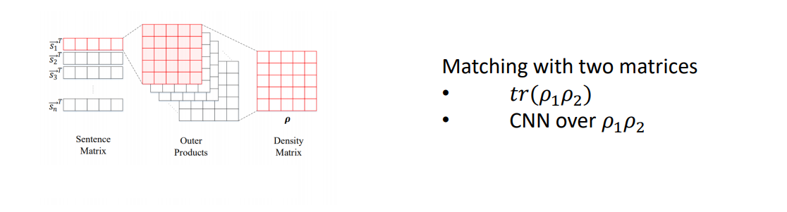
End-2-end Language model for QA
Zhang Peng, Niu Jiabing, Su Zhan, Wang Benyou et al. End-to-End Quantum-like Language Models with Application to Question Answering AAAI 2018

Slide 11
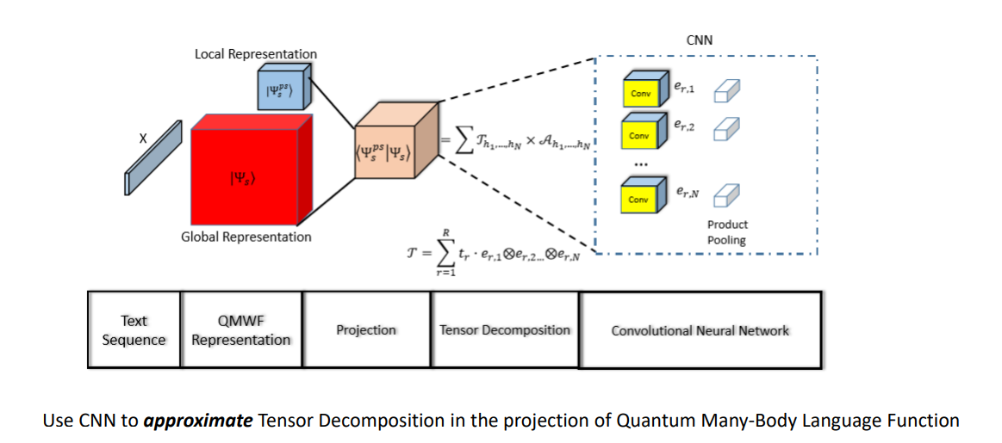
Quantum many-body function for LM
Peng Zhang, Zhan Su, Lipeng Zhang, Benyou Wang , Dawei Song. 2018. A Quantum Many-body Wave Function Inspired Language Modeling Approach, CIKM 2018

Slide 12
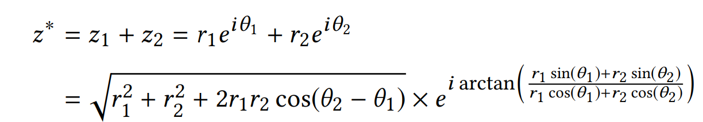
Complex word-embedding
Super-linearity superposition with phase
Li Qiuchi, Uprety Sagar, Wang Benyou , Song Dawei Quantum-inspired Complex Word Embedding, ACL 2018 3rd Workshop on Representation Learning for NLP , ACL 2018 RepL4NLP

Slide 13
Hibert Semantic Space
Unify these four things in a complex-valued space
Semeses
Word
Phrase/Sentence/Documents
Topic as measurements

Slide 14
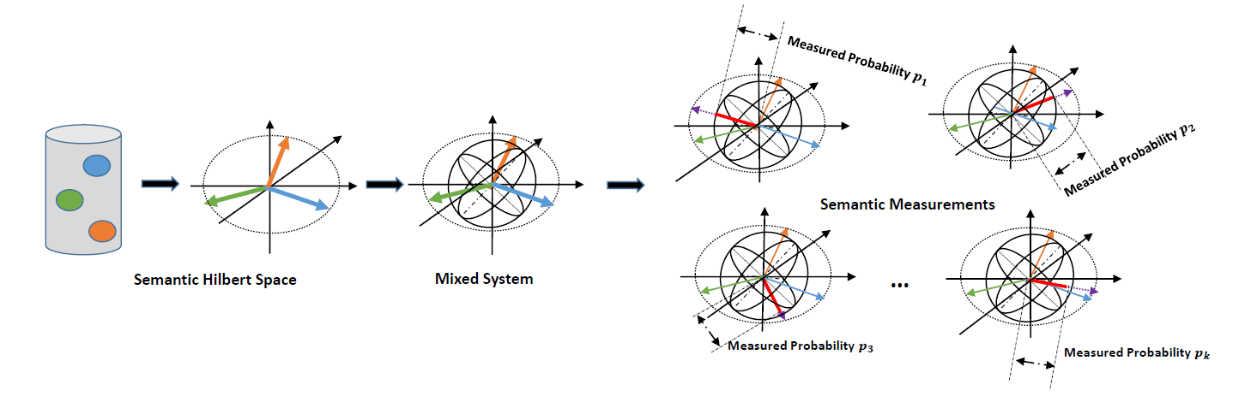
Framework

Slide 15
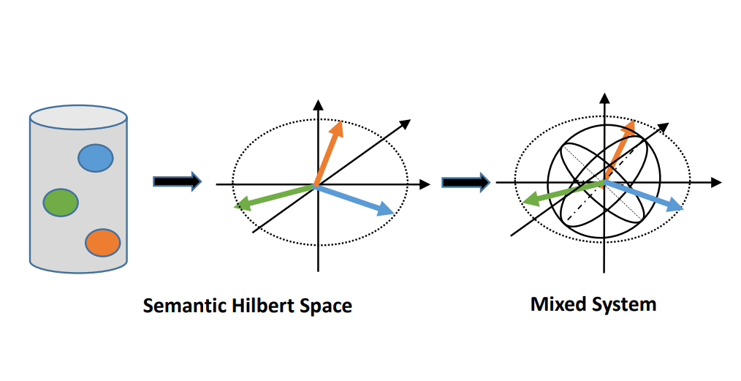
Definition
Semeses as basic state
Word as superstition state
Sentence as mixed system

Slide 16
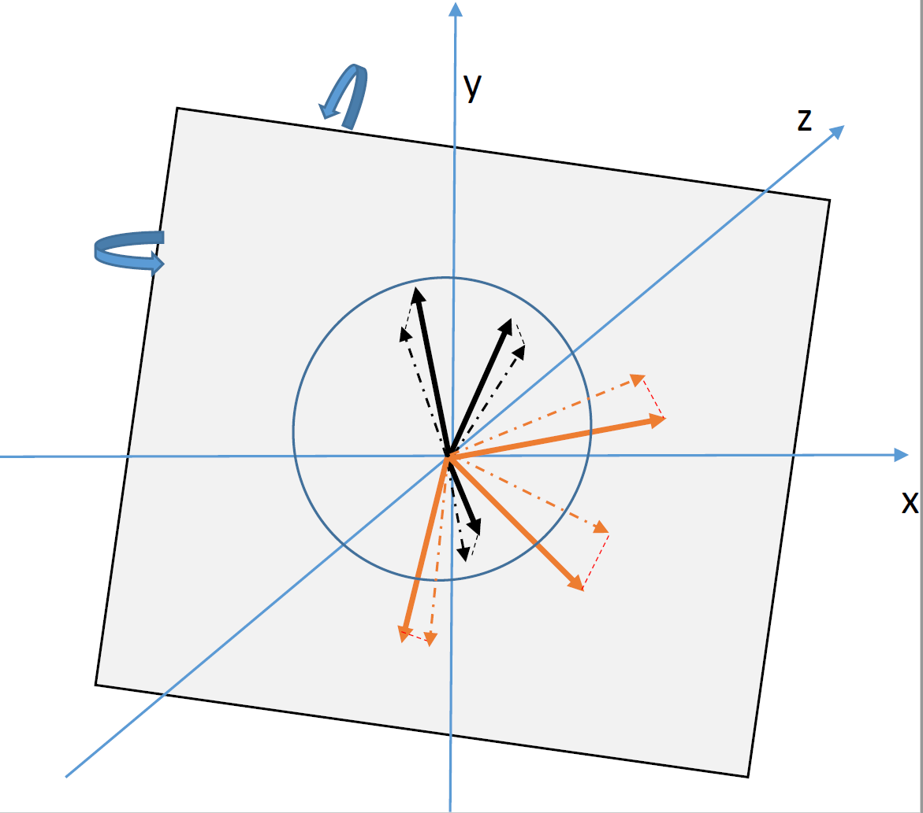
Trainable Measurements for sentence classification

Slide 17
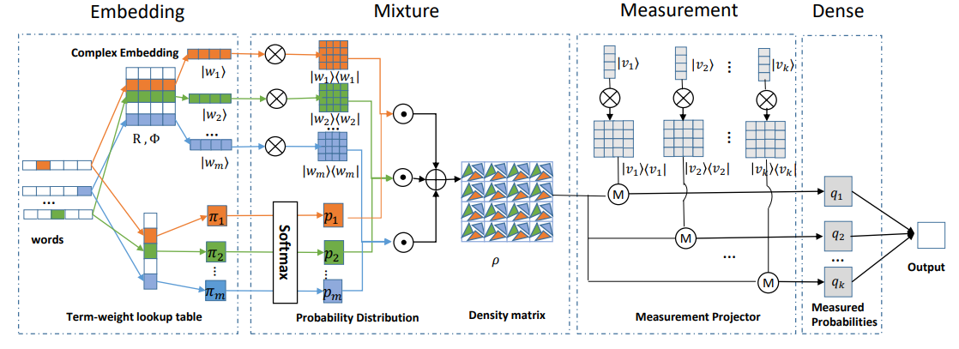
Implements

Slide 18
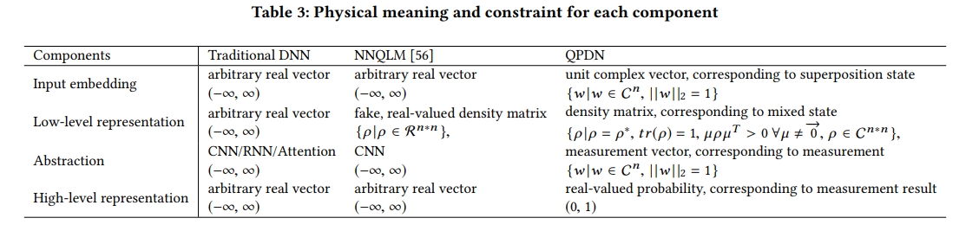
Physical meaning for our models

Slide 19
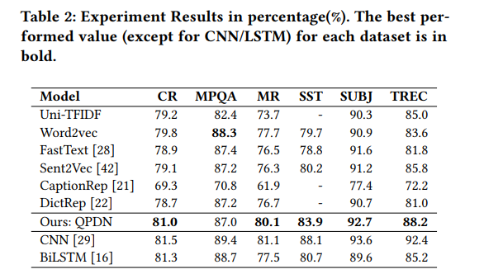
Experiments

Slide 20
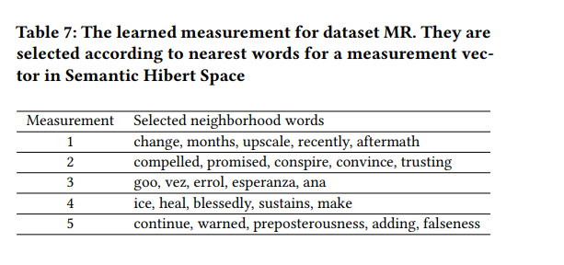
Case study for our measurement

Slide 21
Conclusion
More concrete physical meaning
Self-explainable subcomponents
More constrain for the subcomponents
Guided by Quantum probability theory

Slide 22
Future works with this topic
Explore high-dimension tensor network with Quantum representation
Capsule Network with Quantum insights

